Slide 1
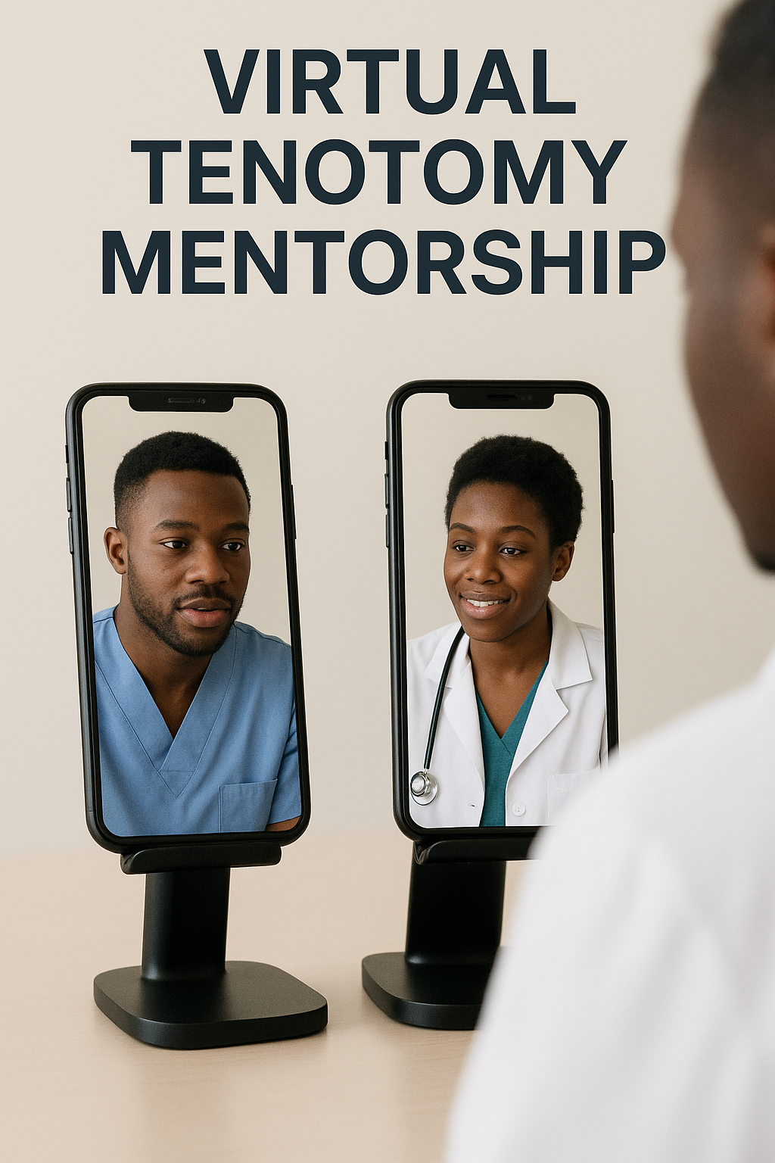

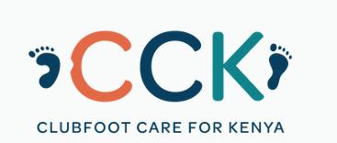
Notes:
Breaking Barriers in Clubfoot Care: Clubfoot Care for Kenya’s Integration of OHANA ONE’s
Digital Surgical Mentorship Model into Tenotomy Training.

Slide 2
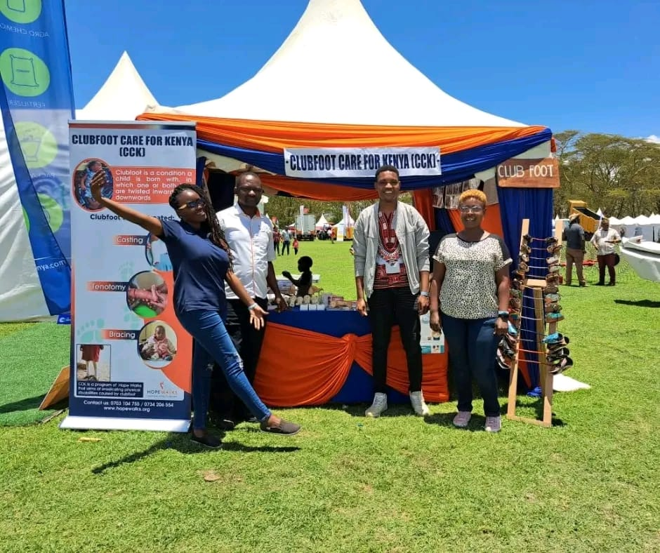
Notes:
The Clubfoot care for Kenya team in an exhibition in Naivasha.

Slide 3
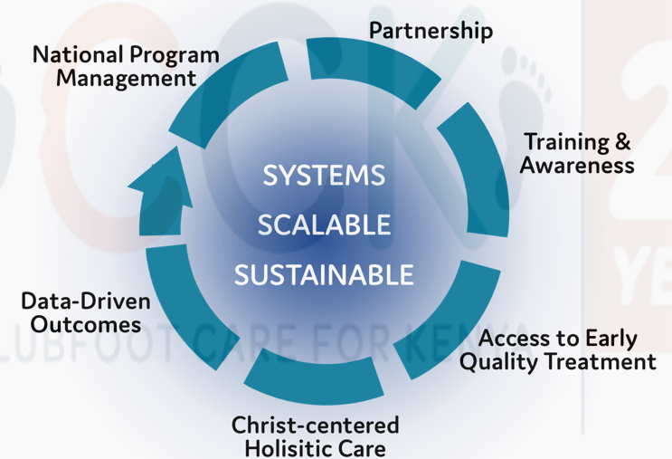
Notes:
The model of clubfoot care for Kenya.

Slide 4
Notes:
Clubfoot, also known as Congenital Talipes Equinovarus, is a developmental deformation where an infant's foot turns inward and downward during the second trimester of pregnancy.³ It is one of the most common congenital orthopedic deformities affecting 1-2 per 1000 live births.
More than 90% of clubfoot cases are born in low-and middle-income countries where clubfoot disability is often poorly understood, and treatment is unavailable.²
If not treated, clubfoot can lead to lifelong disability and pain.
Especially in low- and middle-income countries, children with disabilities often face reduced access to education, health care, assistive technology, socialization, and income opportunities.⁵ These children are also at greater risk of neglect and violence.⁸

Slide 5
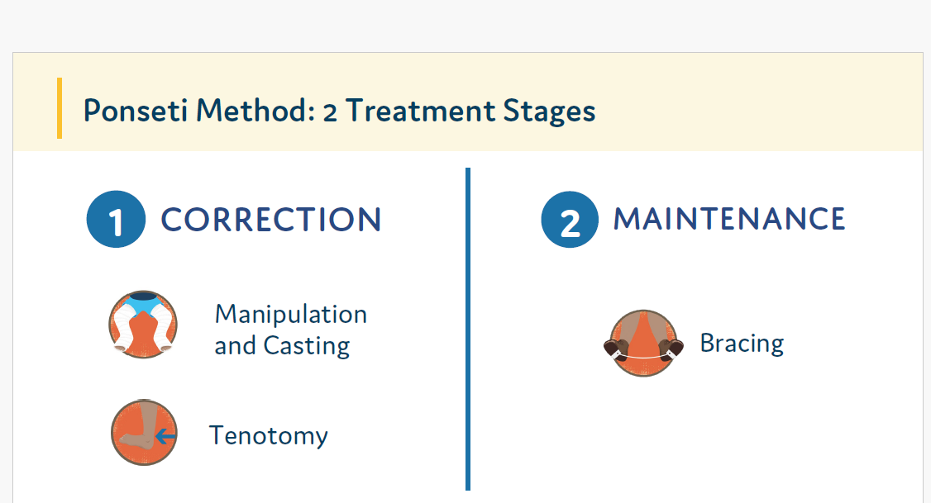
Notes:
The management of congenital clubfoot in Kenya continues to face challenges. It involves two main stages: correction and maintenance. Tenotomy is a crucial procedure that must be done in the correction phase before the child moves into the maintenance stage. It acts as a transition to the next stage.

Slide 6
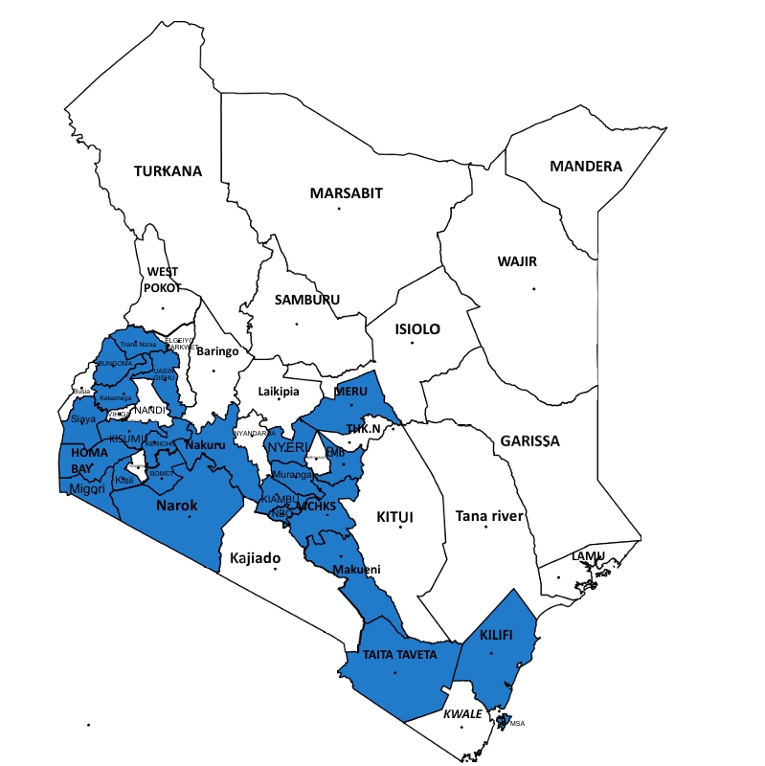
Notes:
Average: 1 per 806 live births. Global estimates: 174,000 new cases per year, 180,000 in low & middle-income countries (more than 90%). CCK is partnering with 29 health facilities. There is a great challenge in accessing tenotomy clinicians in all these clinics due to the gap in surgical skill.

Slide 7
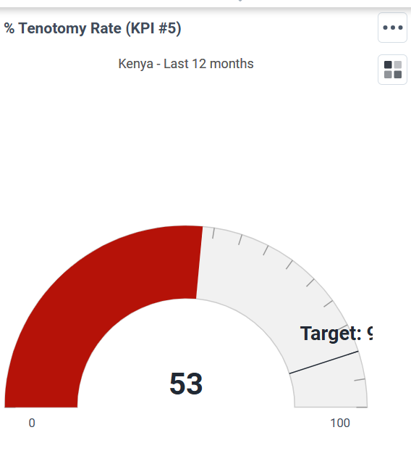
Notes:
Currently, the national tenotomy rate is at 53%. Accessing specialized surgical mentorship for the tenotomy procedure is a critical step in achieving
optimal outcomes using the Ponseti method.

Slide 8
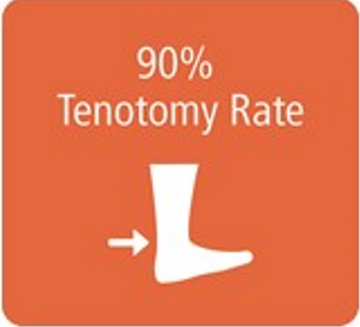
Notes:
Tenotomy rate should be at 90%- This means that in every 10 children born with clubfoot, 9 of them will require this crucial surgical procedure.

Slide 9
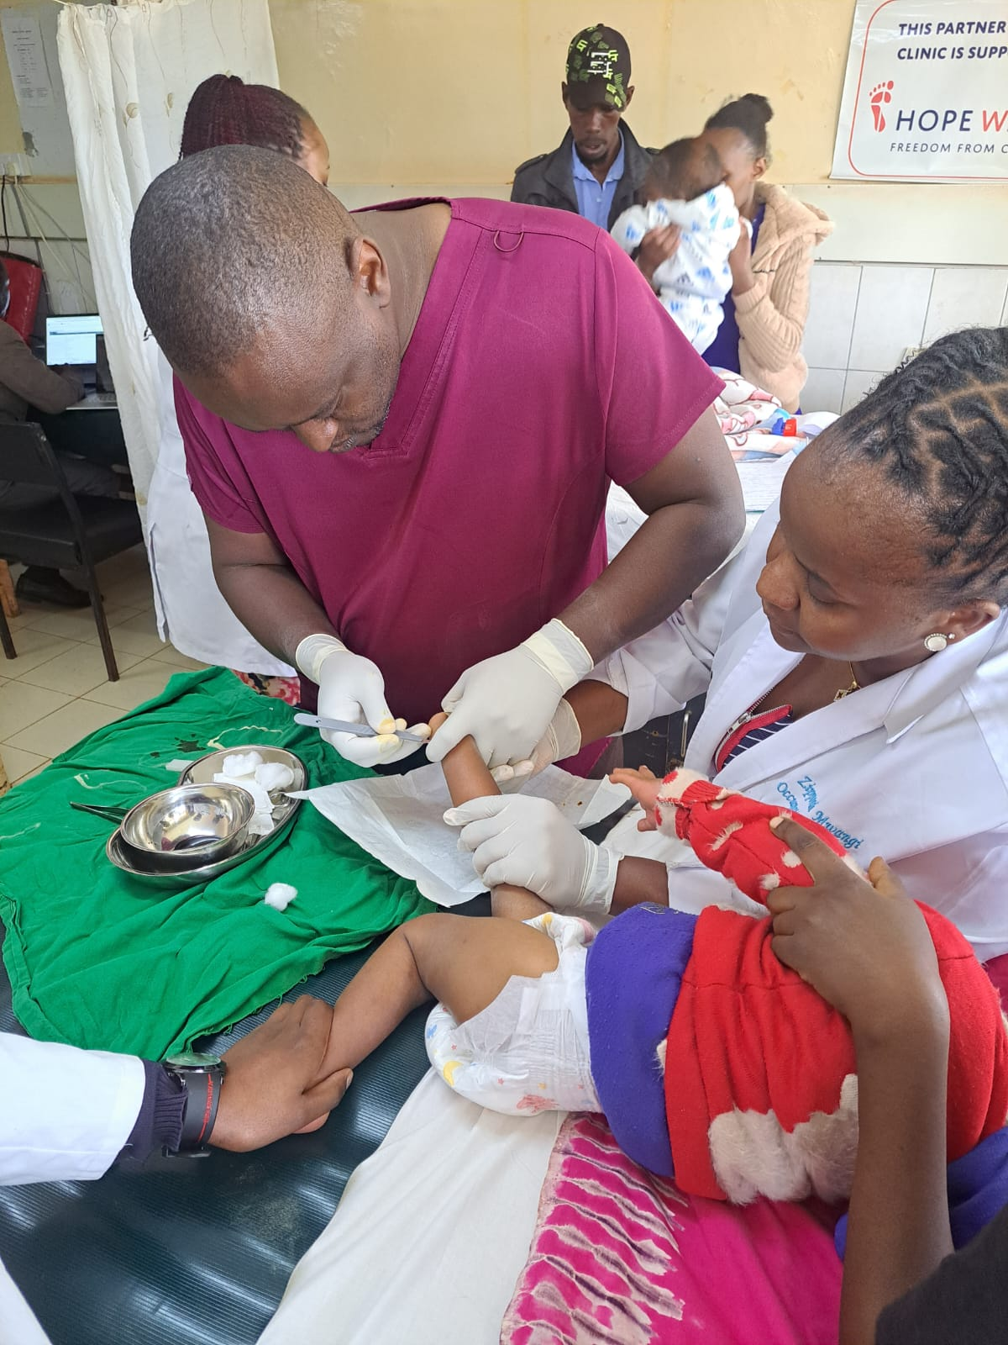
Notes:
A clinician performing tenotomies in one of our partnering clinics. Tenotomy is a through-and-through cut of the Achilles tendon. The tendon regrows approximately after 3 weeks in a lengthened manner if proper casting is applied.

Slide 10
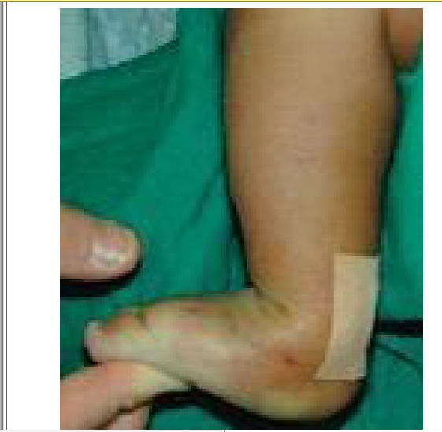
Notes:
The purpose of doing the tenotomy is to release the tendon and relieve the equinus that is very evident in clubfoot. A pic showing what we achieve after the tenotomy.

Slide 11
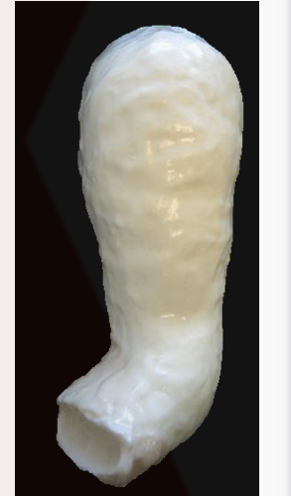
Notes:
The last cast is applied for 3 weeks. This is to give time for the Achilles tendon to attach in a lengthened way and for the small skin opening to heal.

Slide 12
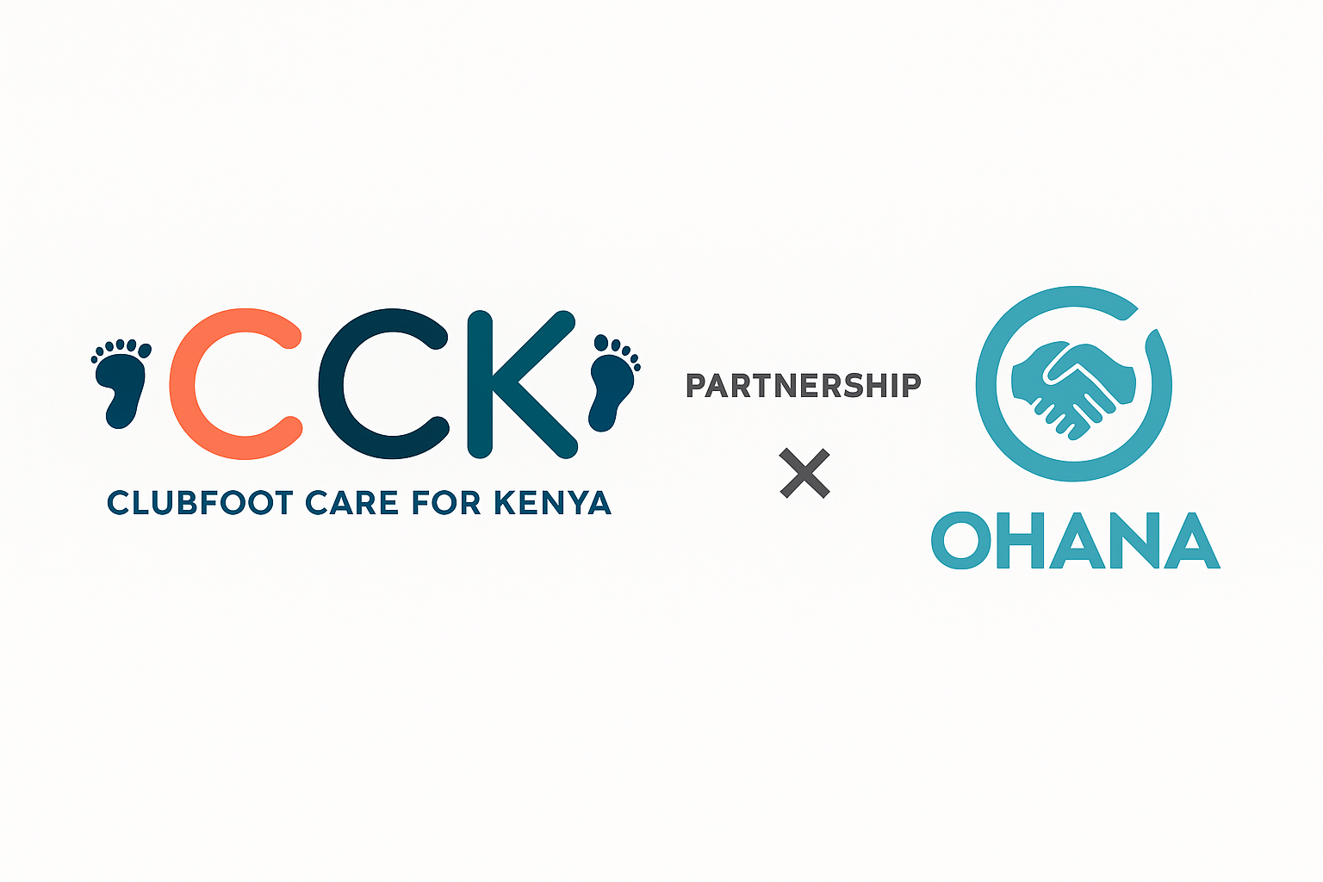
Notes:
Clubfoot Care for Kenya (CCK), in collaboration
with OHANA ONE, has launched an innovative remote mentorship program to address this gap.
The initiative provides smartphones to clinicians in public hospital clubfoot clinics, enabling
secure, real-time connections with expert mentors. Through live video guidance, case discussions,
and post-procedure feedback, the program strengthens clinical decision-making and procedural
proficiency without requiring a physical mentor presence.

Slide 13
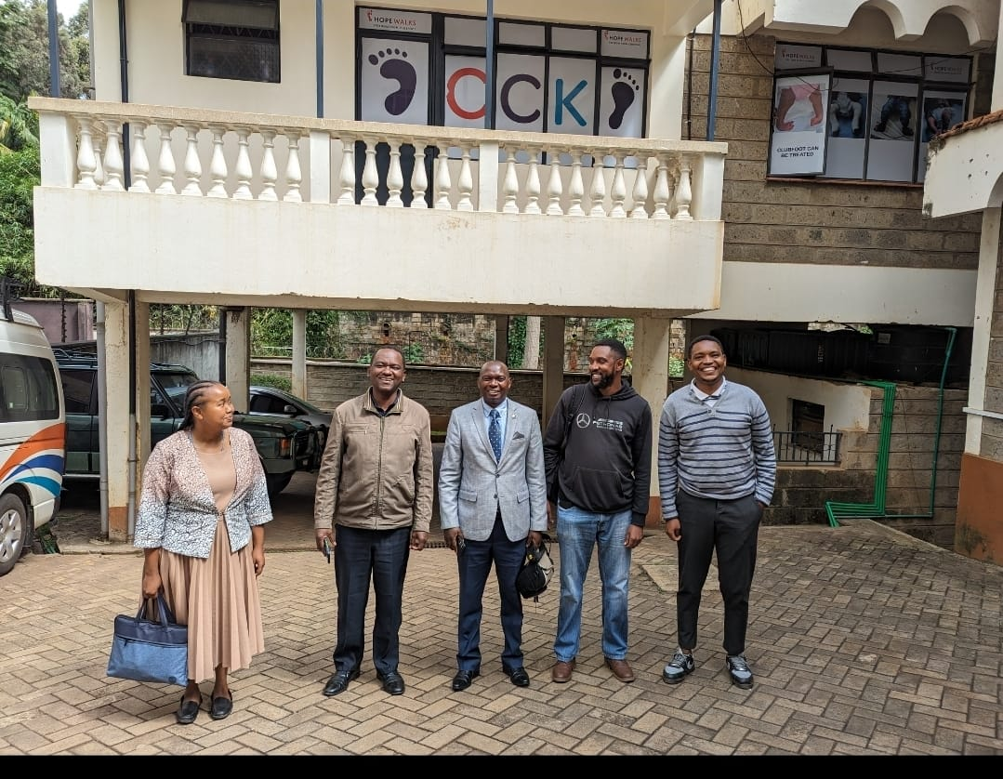
Notes:
The Ohana one – Kenya team in the CCK offices.

Slide 14
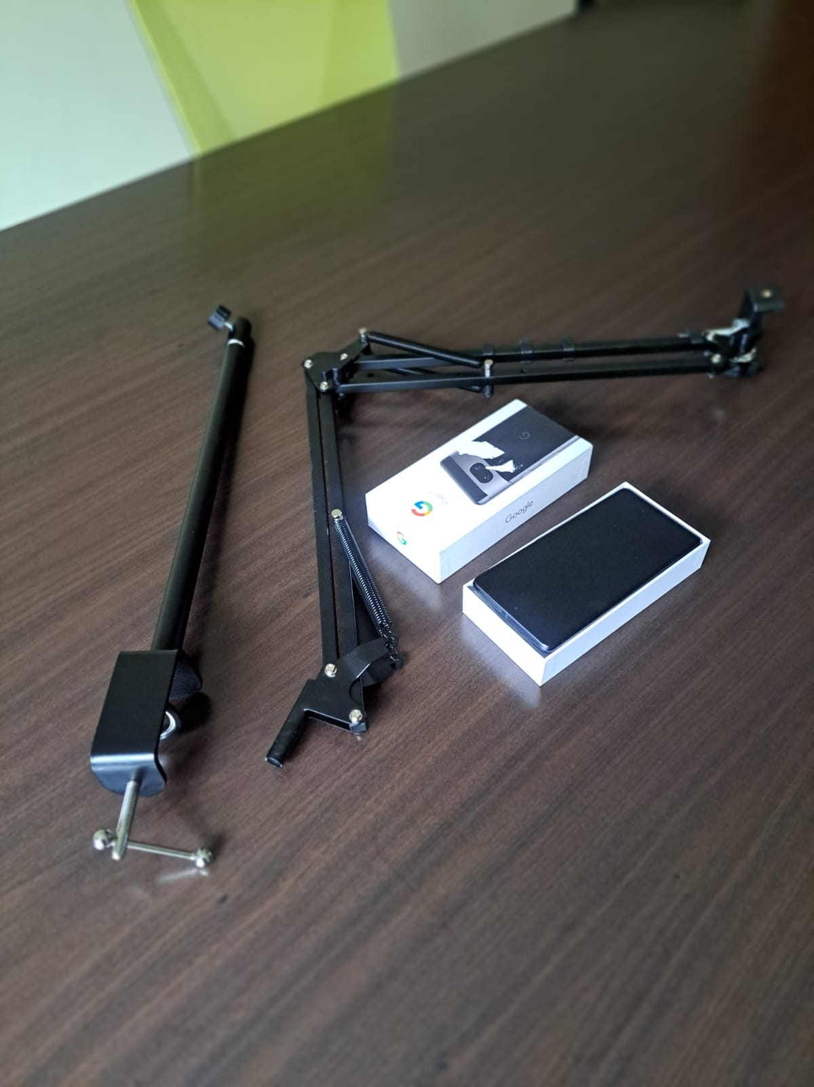
Notes:
The initiative provides smartphones to clinicians in public hospital clubfoot clinics, enabling
secure, real-time connections with expert mentors. The package involves a phone with good video quality, a charger, and an adjustable stand to free the clinician’s hand.

Slide 15
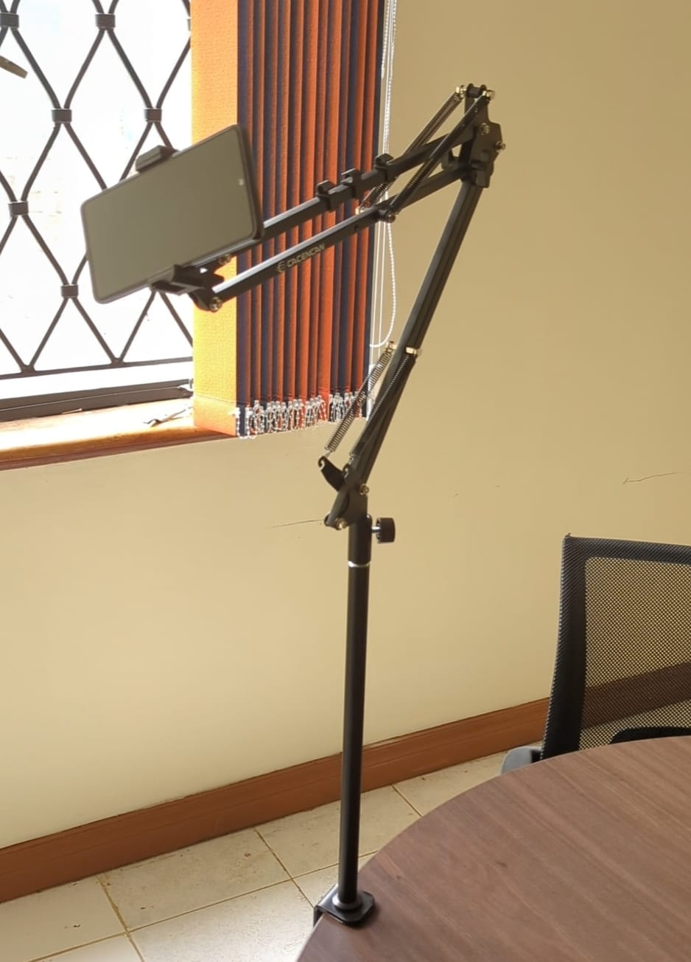
Notes:
This is how the setup looks for both the mentor and the Mentee.

Slide 16
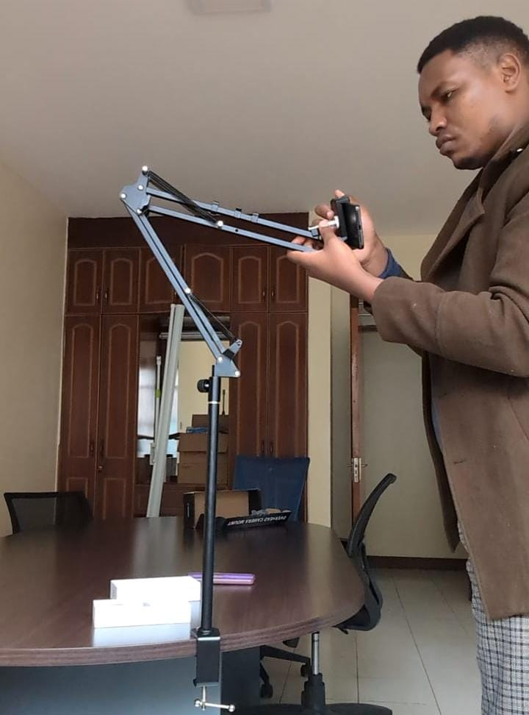
Notes:
Using the Camviu platform, mentors guide mentee tenotomists step-by-step through procedures,
providing structured, competency-based training and ongoing feedback. Malindi Sub-County
Hospital’s clubfoot clinic received a tenotomy training kit through an OHANA ONE grant,
powered by Help Lightning and Camviu applications

Slide 17
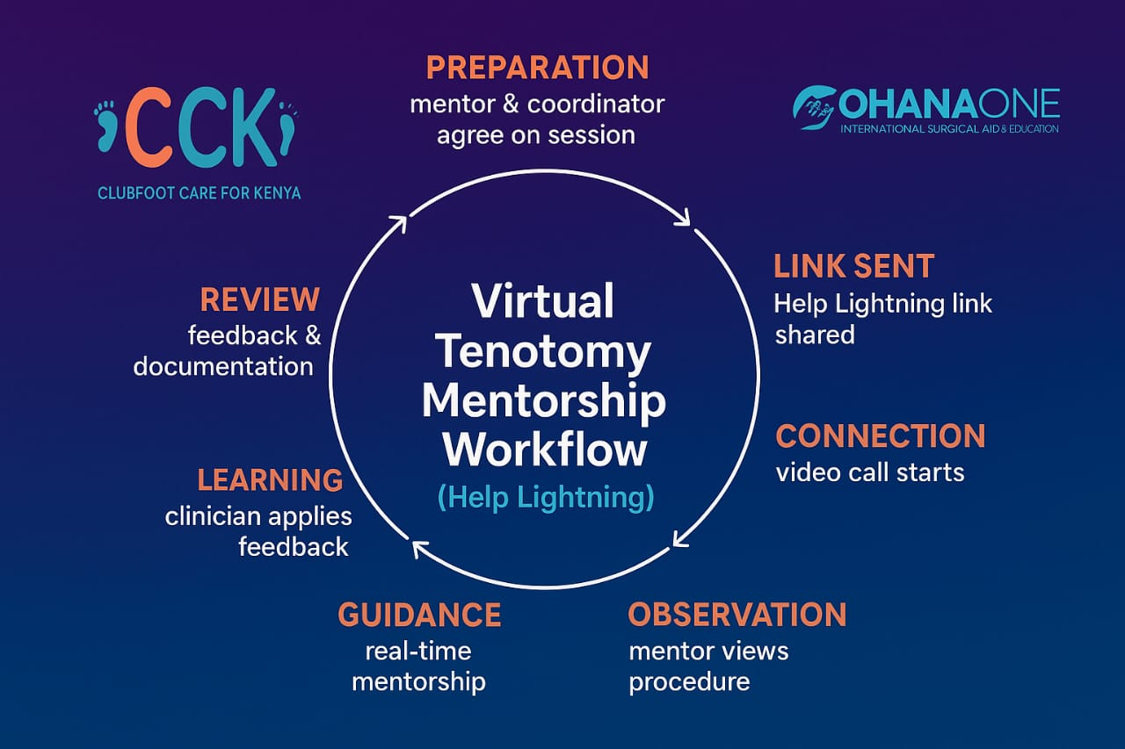

Slide 18
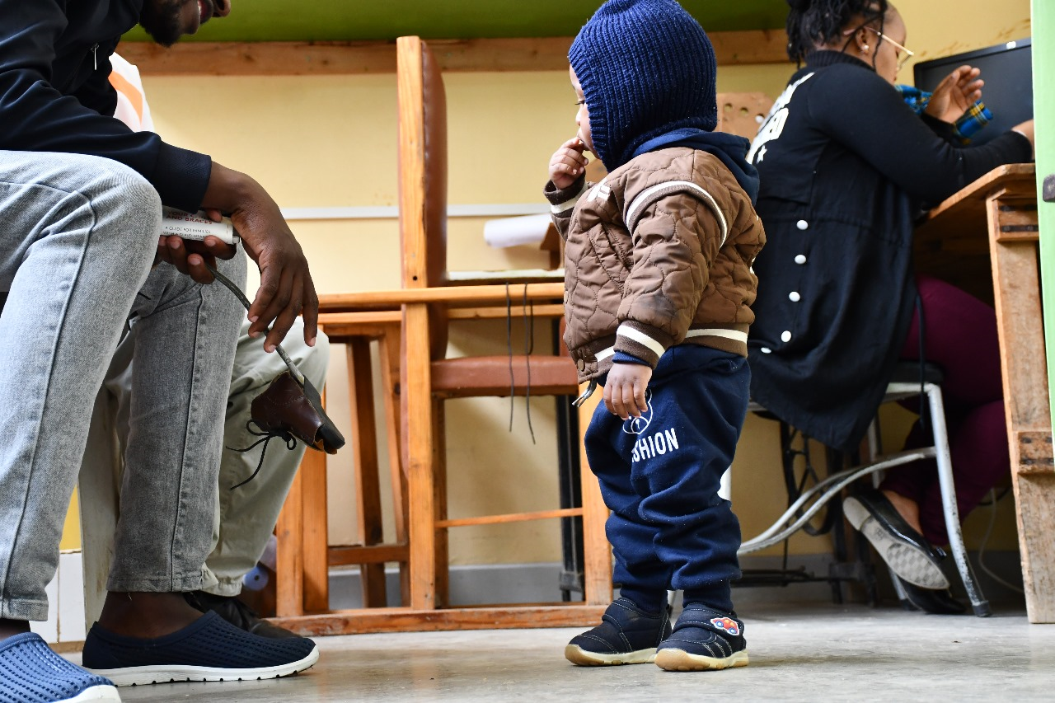
Notes:
Child walking free from clubfoot deformity. Now on the bracing stage.

Slide 19
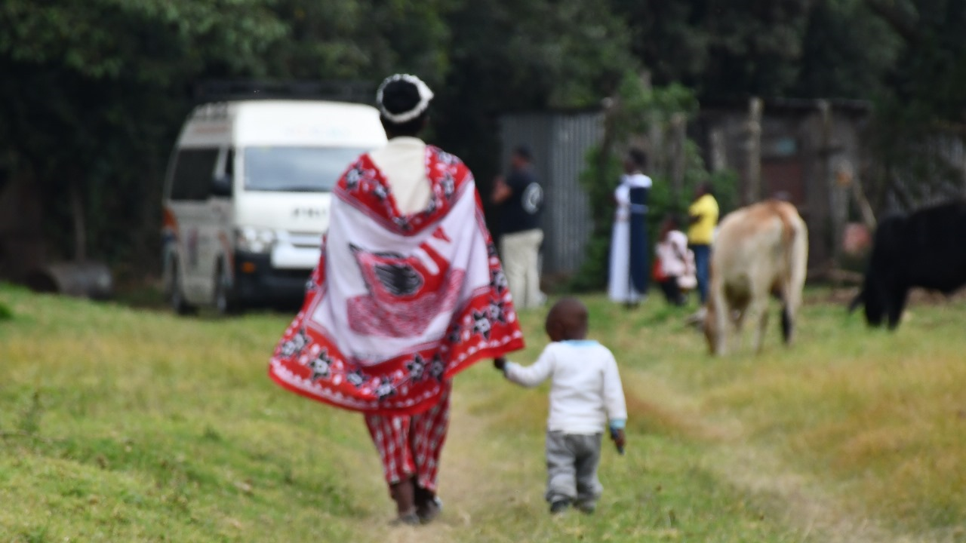
Notes:
With the Ponseti method of clubfoot management clubfoot can be treated.

Slide 20
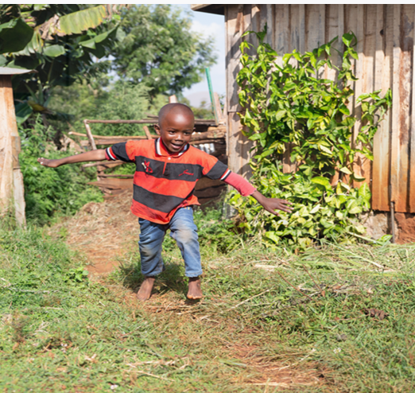
Notes:
Thank you: Photo courtesy of Hopewalks org.

